Slide 1

happy
SHOW

Slide 2

sick
SHOW

Slide 3
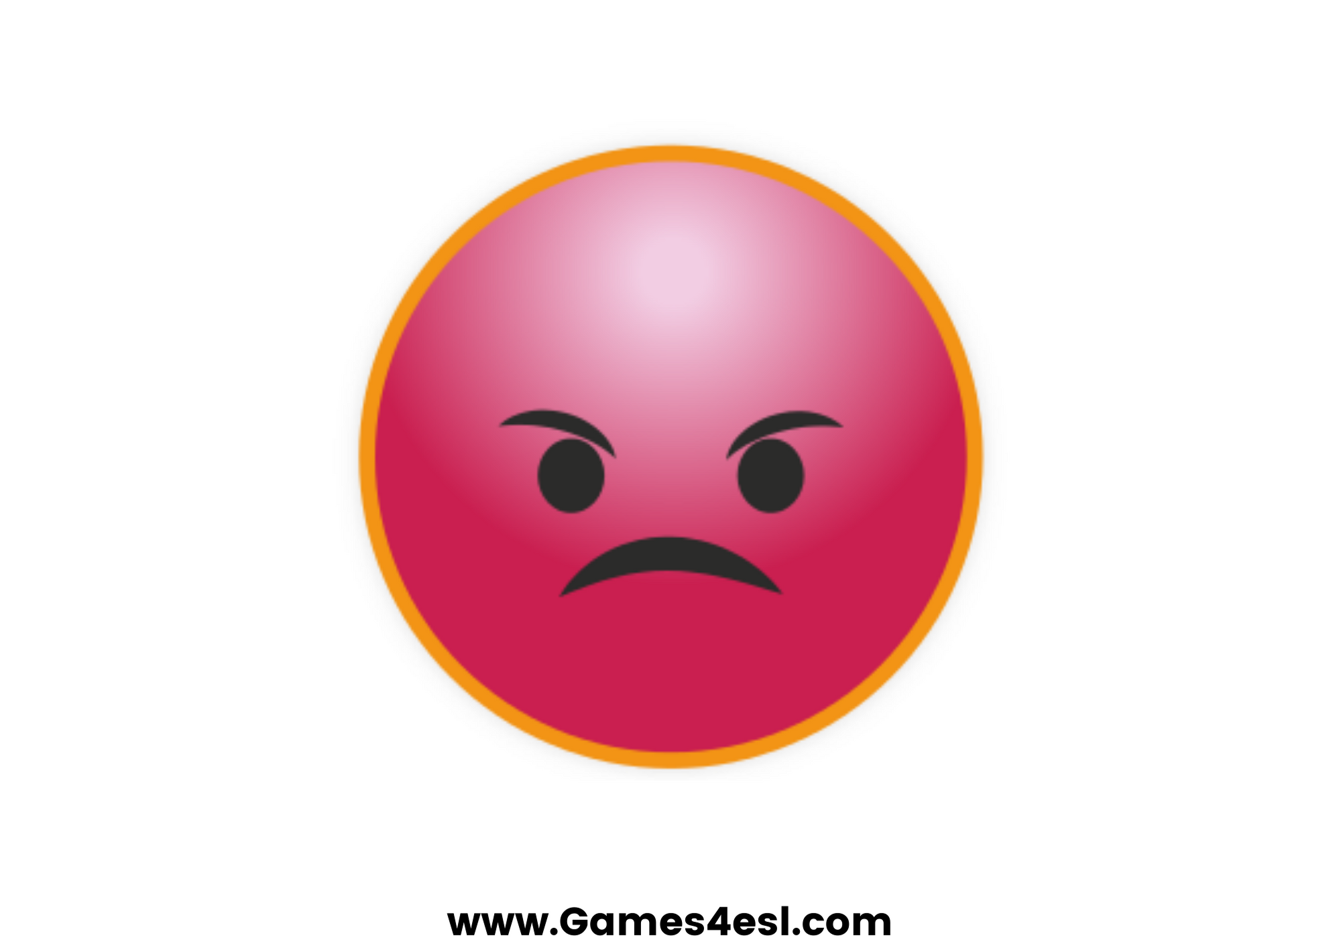
angry
SHOW

Slide 4
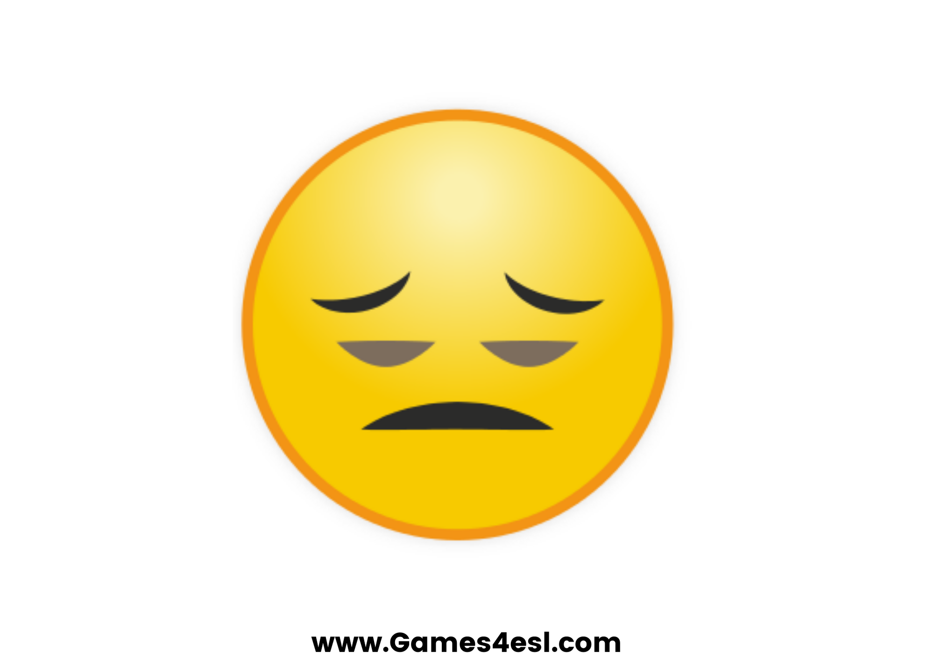
tired
SHOW

Slide 5

hungry
SHOW

Slide 6
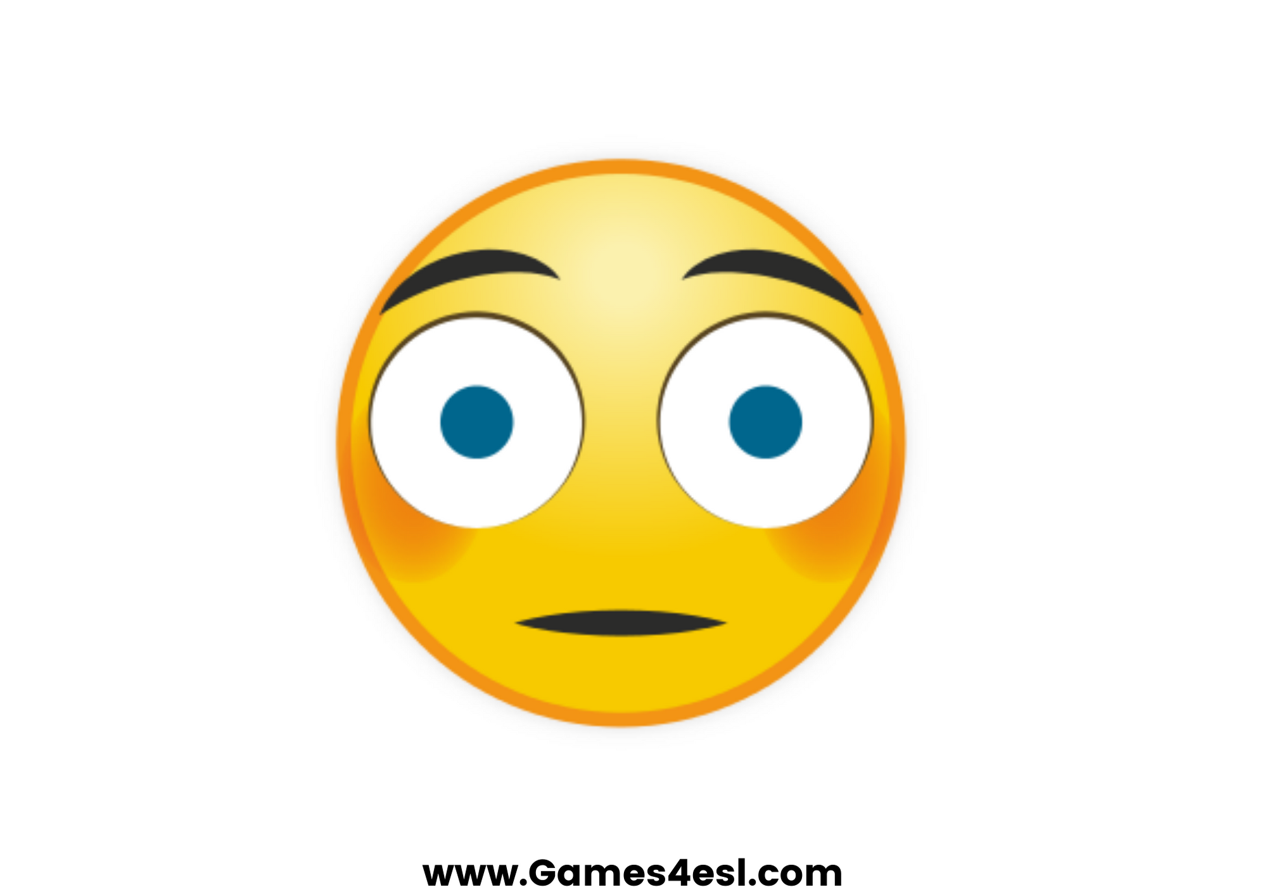
scared
SHOW

Slide 7

bored
SHOW

Slide 8
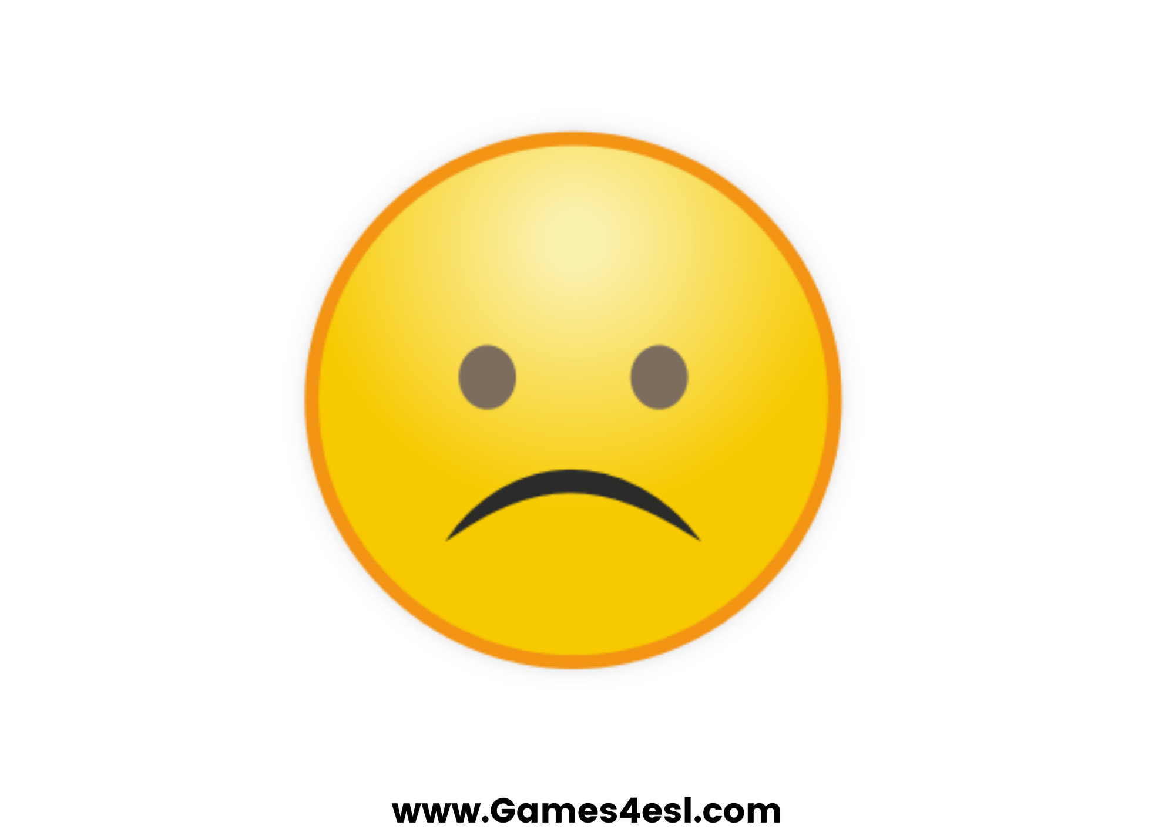
sad
SHOW

