Slide 1

q the uvular stop
Notes:
This video will help you to learn to make and describe the Halq’emeylem sound q, and to distinguish it from other sounds especially the regular k

Slide 2
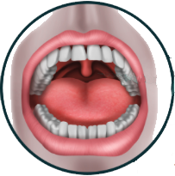
Uvula
Dangles at the back
Notes:
The Halq’emeylem q sound is made at the UVULA, which is the fleshy lump that dangles down at back of your throat. Seen from the front the uvula looks like THIS.

Slide 3
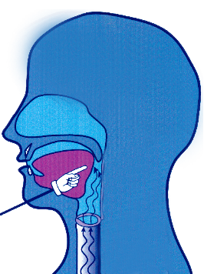
SIDE VIEW
Uvula is HERE at
the back
Notes:
Seen from a SIDE VIEW, the uvula is HERE, right at the BACK

Slide 4
Stop HERE
Notes:
To make the correct Halq’emeylem q-sounds, what you do is you pull the back of your tongue waaay back so that it touches your uvula, and stops the airflow by touching for a moment there.

Slide 5
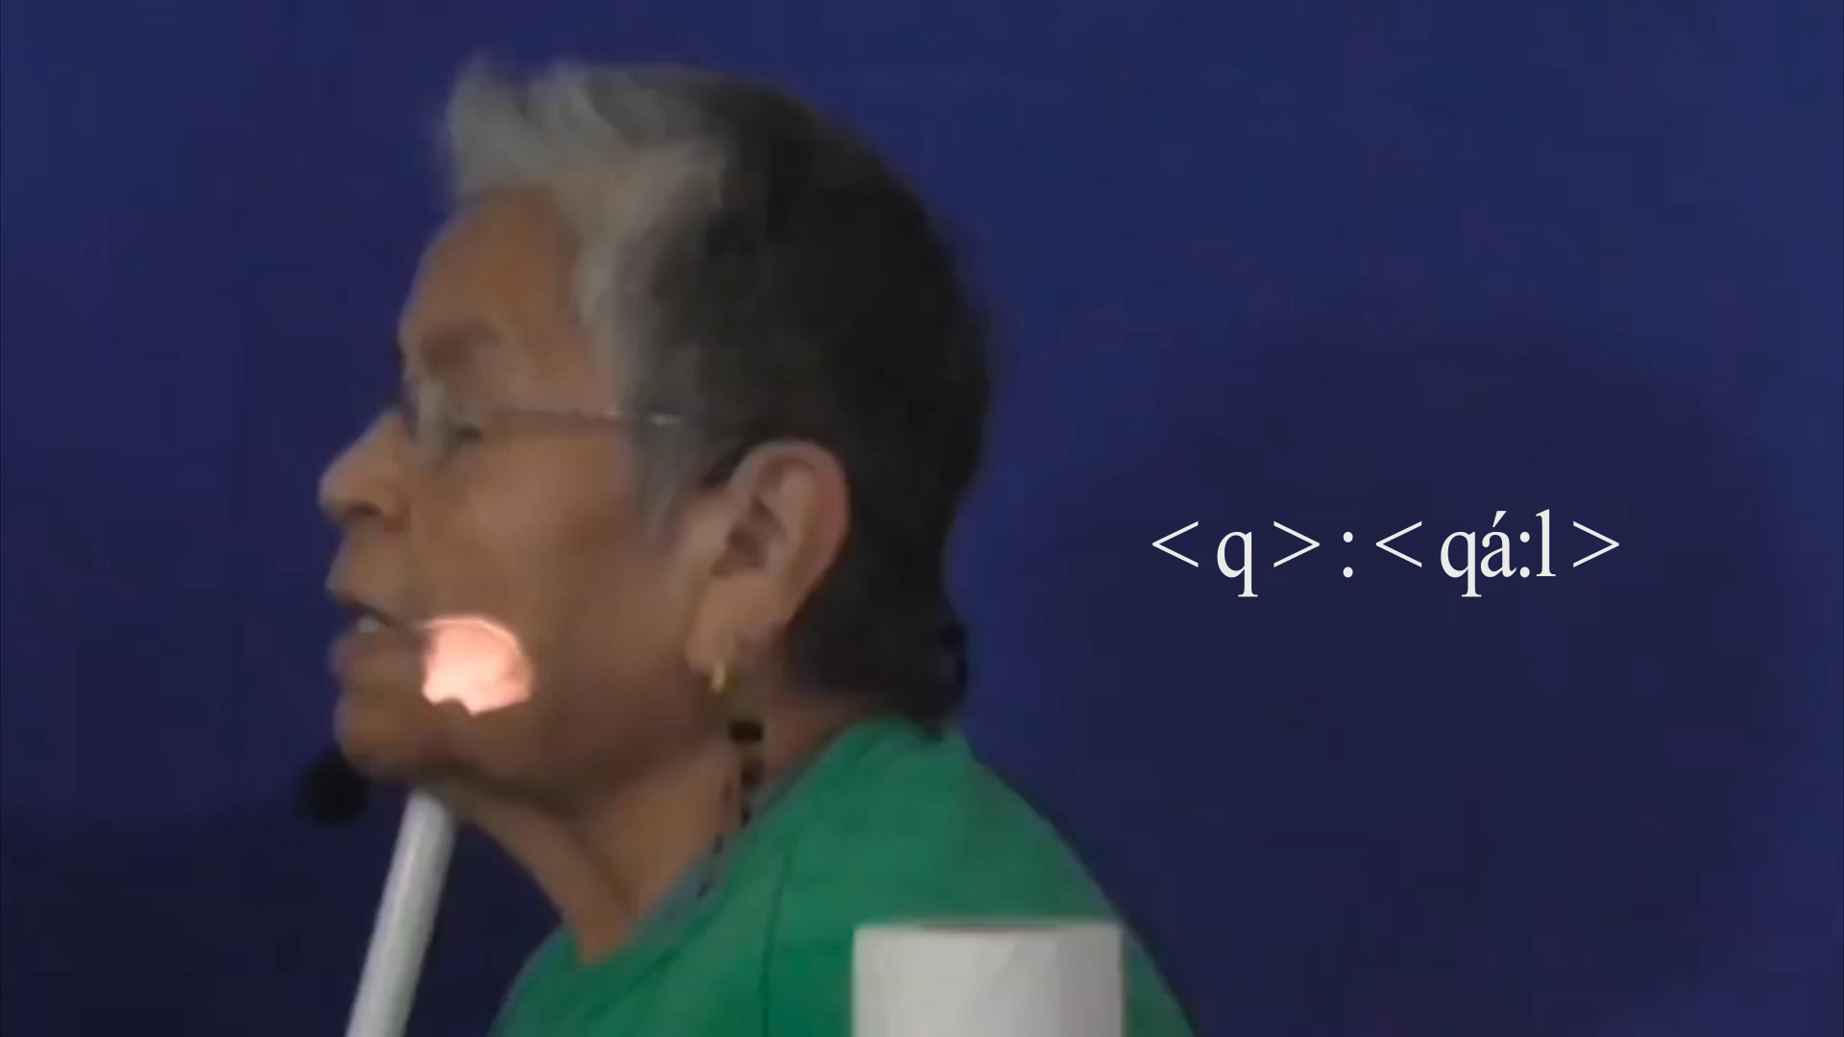
Elder Siyamiyateliot demonstrates pronunciation for q
Notes:
Let’s watch and listen as Elder Siyamiyateliot says the Halq’emeylem word for ‘to steal’, which begins with the uvular q-sound
Now listen to my granny say it:

Slide 6
Careful!
q ≠ k
Notes:
To English speakers, the Halq’emeylem q sounds a lot like the regular k sound. But be careful!! The Halq’emeylem q is NOT the same as a regular k. They are different sounds in the language.

Slide 7
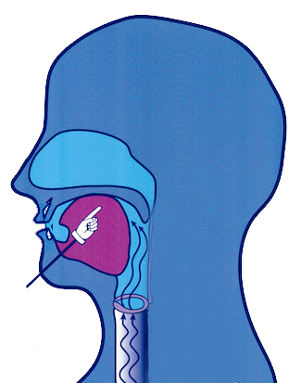
k
q
/ q / stops air HERE
/ k / stops air HERE
Notes:
Both are made sort of towards the back, and both do involve stopping the airflow with the tongue. However, the / k / sound is made MUCH further forward on the mouth, more on the roof of the mouth. For the true q in Halq’emeylem, you pull the back of your tongue MUCH further back. This difference in where your tongue touches can completely change the meaning of a word in Halq’emeylem!

Slide 8
English speakers do NOT touch here, even in words like queen or Iraq
What’s spelled q in English is really just the same as k
Notes:
Now, English does have the LETTER q, as in words like QUEEN or IRAQ. But that’s just spelling. English speakers do NOT touch the uvula, even in words like queen or Iraq spelled with q. What’s spelled q is really just the same as k.

Slide 9
Halq’emeylem has the ‘true’ uvular q.
Notes:
However, Halq’emeylem has the ‘true’ uvular q. It actually has BOTH a q AND a k sound, and switching between them is enough to change the meaning of a word.

Slide 10
Summarizing q vs. k
q is SIMILAR TO k in that:
But q is DIFFERENT from k in that:
Both towards the back
Halq’. q touches WAY further back
Both are ‘stop’ sounds
Notes:
[can just read the text, expand a bit, as you run through the fades]

Slide 11

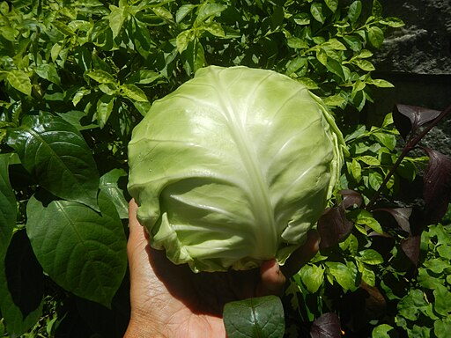
q vs. k (example)
qáqel
kápech
https://commons.wikimedia.org/wiki/File:Flickr_-_USCapitol_-_Fur_Trade.jpg - USCapitol, Public domain, via Wikimedia CommonsWikimedia Commons
https://commons.wikimedia.org/wiki/File:5Repolyo_cabbage_of_the_Philippines_03.jpg - Judgefloro, CC0, via Wikimedia CommonsCommons
--
Notes:
Here are a couple of example words that let you hear the difference between q and k in Halq’emeylem. Qaqel, starting with a q, means ‘housepost’, where-as kapetch, starting with a k, means cabbage. There are actually only a FEW words that have the pure k sound in Halq’emeylem, most of them borrowings from other languages.

Slide 12
Side note q in other languages
In Hul’q’umi’num’ and hən̓q̓əmin̓əm q (same)
In Squamish the same sound is written k
Linguistic IPA symbol is / q /
Notes:
The true uvula q sound occurs in most Salish languages. It is usually written as q, but sometimes, as in Squamish the same sound is written as an underlined k. In the Linguistic IPA symbol system it is a q.
This sound does not occur in English, but it does occur in many other languages. The true uvula q is common in languages in the Middle East, such as Arabic, as well as in many other First Nations language groups in North America.
In the linguistic IPA symbols, which you may sometimes see used in dictionaries etc., the official symbol is a q. Remember that any English words spelled q (like queen) do NOT have a true uvula stop, they are just the same as k!

